Slide 1

Understanding Streaming
Analytics
Disclaimer:
IBM’s statements regarding its plans, directions, and intent are subject to change or withdrawal without notice at IBM’s sole discretion. Information regarding potential future products is intended to outline our general product direction and it should not be relied on in making a purchasing decision. The information mentioned regarding potential future products is not a commitment, promise, or legal obligation to deliver any material, code or functionality. Information about potential future products may not be incorporated into any contract. The development, release, and timing of any future features or functionality described for our products remains at our sole discretion.
© 2018 IBM Corporation
Notes:
This deck is intended to provide a technical sales specialist (TSS) all the material need to cover IBM Streams from elementary (explaining stream computing and why it’s important) to a deeper dive in the Streams paradigm and specific features. It tries to provide a justification for each of the features discussed (answering the “so what?” question).
Do not attempt to present this deck in its entirety to a customer. Pick and choose the slides that are relevant to the customer’s industry and possible use cases, and fit your selection in the time allotted.

Slide 2
Streaming Analytics: What’s the business value?
Continuous
Always-on analytics for streaming data
Connected
Speed time
to value
Analyze More
Store Less
Act Faster
Complete
Expand insight to data in motion
© 2018 IBM Corporation

Slide 3
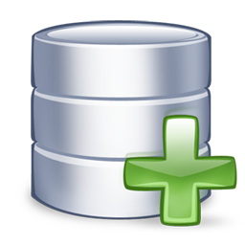
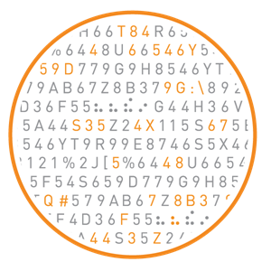
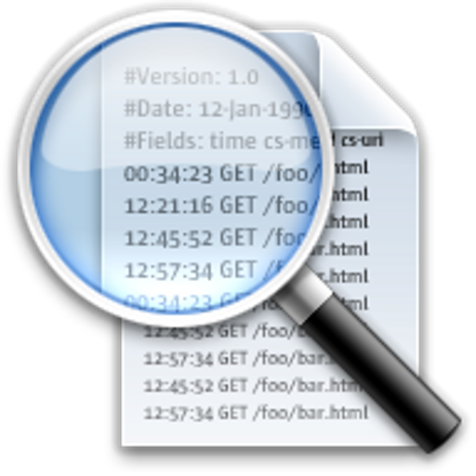

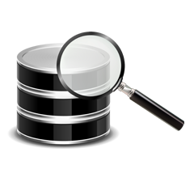
Streaming Analytics – A Paradigm Shift
Traditional Approach
Streaming Analytics
Historical Fact Finding
Analyze Persisted Data
Batch Philosophy
Pull Approach
On-Demand
Analyze the Current Moment “Now”
Analyze Data Directly “In Motion”
Analyze Data at Speed it is Created
Push Approach
Continuous Insights
Aggregate
Data
Analysis
Insight
Data
Store
Analysis
Insight
Raw
© 2018 IBM Corporation
Notes:
Context-aware stream computing is different from the traditional store-first-then-analyze paradigm – the left shows the traditional way data is accessed using queries to pull the data from a data storage device such as a data warehouse or database – which is still valid for many requirements.
The new context-aware stream computing paradigm brings data to the query – data is pushed or flows through the analytics.
Common drivers for those new use cases include:
When you need an immediate response/action and persisting and analyzing stored data isn’t fast enough.
When it is too expensive to store the data to be analyzed – for example, when most of it is throw-away and its more efficient to analyze/filter as you receive it and store the filtered results.

Slide 4
Streaming Analytics Application Pattern
Ingest
Prepare
Detect &
Predict
Decide
Act
Sensors
Social
Machine Data
Location
Audio
Video
Text
Transform
Filter
Correlate
Aggregate
Enrich
Classification
Patterns
Anomalies
Scoring
Events
Business Rules
Conditional Logic
Notify
Publish
Execute
Visualize
Store
Warehouse, Hadoop, Cloud Object Store, SQL, NoSQL Files
Ingest data from many sources & prepare it for analysis
  Transform, filter, correlate, aggregate and enrich the data for analysis
Detect & predict events and patterns in the data
Decide how the results should be handled and act on them
Store any data that is of longer term value
© 2018 IBM Corporation
Notes:
Streams is a development platform for limitless applications of real-time analytics, and you can program it to do just about anything. However, there is a universal pattern to how Streams applications are designed. And keep in mind that Streams always is just one element in a larger analytical architecture and must connect to multiple external systems to bring in data and send out results.
The Stream Computing application pattern is:
Ingest data from many sources & prepare it for analysis
Any kind of data: sensors, social, machine data, location, audio, video, text
Prepare: transform, filter, correlate, aggregate and enrich the data for analysis
Detect & predict events and patterns in the data
Classification, patterns, anomalies, scoring
Decide how the results should be handled and act on them
Business rules, conditional logic
Store any data that is of longer term value
Warehouse, Hadoop, operational store, files

Slide 5

IBM Streams at a Glance
Out of the box with nearly 200 operators with 1300 functions
and dozens more in github.com/IBMStreams
Communications Data Sources
Internet (TCP/IP, UDP/IP, HTTP, FTP, RSS)
Messaging (Kafka, XMS, IBM MQ, Apache ActiveMQ, RabbitMQ, MQ TT, MQ Low Latency Messaging)
IBM DataStage
IBM Data Replication
Hadoop
Hadoop
HDFS, GPFS, Hive, Hbase, BigSQL, Parquet, Thrift, Avro
IBM Streams
Scale-out Runtime
RDBMS
IBM DB2, IBM DB2 Parallel writer, IBM Informix, IBM BigInsights BigSQL, IBM Netezza, IBM Netezza NZLoad, solidDB, Oracle, Microsoft SQL Server, MySQL, Teradata, Aster, HP Vertica
Data Warehouse
NoSQL
NoSQL
Key Value Stores (HyperState Accelerator, Memcached, Redis, Redis-Cluster, Aerospike)
Column Oriented Stores (Cassandra, Hbase)
Document Oriented Stores (IBM Cloudant, Mongo, Couchbase)
Primary Analytics
Application Development
Java
Scala
Python
Streams Processing Language (Drag & Drop)
Filter
Enrich
Normalize
Windowed Aggregations
Machine Learning
Scoring (SPSS, Python, R, MLlib)
Signal Processing
CEP & Pattern Matching
Geospatial
Video/Image
Text Analytics (AQL)
Speech to Text
Rules
Deep Packet Inspection
© 2018 IBM Corporation

Slide 6










IBM Streams addresses industry challenges
 | Telecommunications Call center agent assist CDR processing Network monitoring Next best action Geospatial analytics |  | Law Enforcement, Defense and Cyber Security Real-time multimodal surveillance Situational awareness Cyber security detection Data Leakage
 | Transportation Intelligent traffic management Automotive telematics Trend Detection |  | Finance and Banking Impact of weather on securities prices Analyze market data at ultra-low latencies Marketing next best action Regulatory monitoring and Audits
 | Energy & Utilities Network monitoring Transactive control Phasor Monitoring Unit Down hole sensor monitoring |  | Insurance and Fraud prevention Detecting multi-party fraud Real time fraud prevention Know your customer (360) Next best action
 | Health & Life Sciences ICU patient monitoring Epidemic early warning system Remote healthcare monitoring Transcription Services |  | e-Science Space weather prediction Detection of transient events Synchrotron atomic research Genomic Research
 | Natural Systems Wildfire management Water management |  | Cross industry Call center agent assist Social and news text analysis Intelligent Ingest
© 2018 IBM Corporation

Slide 7
IBM Streams Toolkits
Avro | CEP | Cybersecurity
DateTime | DPS | ElasticSearch
EventStore | Geospatial | hbase
HDFS | Inet | IoT
JDBC | JMS | JSON
Kafka | Mail | MessageHub
Messaging | MQTT | Network
ObjectStorage | PMML | R-project
RabbitMQ | Rules | RulesCompiler
SparkMLLib | Speech2Text | SPL
TEDA | Text | Time Series
Topology | Watson Explorer
Included in IBM Streams
Require explicit inclusion in projects
37 toolkits
  Over 200 operators
  About 1300 functions
Unmatched Analytics included
  Customize with C/C++, Java, Scala, Python, R scripts
Analytic Toolkits
Notes:
Note that the Network toolkit includes 651 functions!
IBM Analytics
© 2015 IBM Corporation

Slide 8

Streams Machine Learning
Unsupervised: Learn as you go in Streams
  Time Series toolkit has about 20 algorithms
    Continuous update of model and making of predictions
    Anomaly Detection, Classification, Regressions, Clustering, Filtering
Supervised: Learn offline; Score in Streams
  SPSS import: all SPSS models, including data preparation
  PMML import: Classification, Clustering, Regression, Association
  Spark MLLib: Classification, Regression, Trees, Clustering, Filtering
  R scripts: Classification, Regression, Trees, Clustering, Filtering
  Python: Classification, Regression, Trees, Clustering, Filtering
Redeploy updated models without stopping Streams application
Data
Notes:
Again, pretty unique in the industry to have ‘Learn as you Go’ Machine learning models. These don’t need training data, and build up the model as data arrives. As the data is changing, they continually update their models.
Some examples in Python and R
https://www.analyticsvidhya.com/blog/2015/08/common-machine-learning-algorithms/

